Slide 1

Enhanced Facial Detection and Super Resolution
Project Members:
Syed Yasir Ahmed

Slide 2
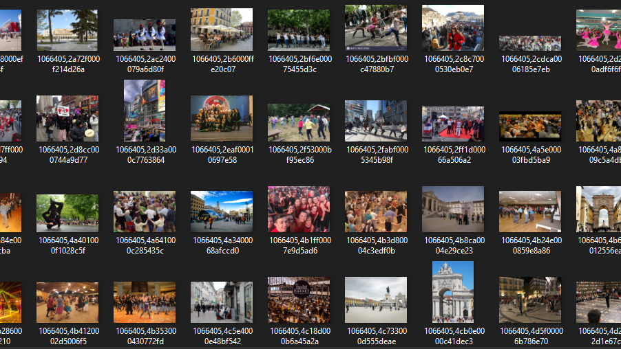
Dataset Used: CrowdHuman

Slide 3
Other Datasets Searched:
JHU Crowd Dataset
Wider Face Dataset
TinyFace Dataset (For Super Resolution)

Slide 4
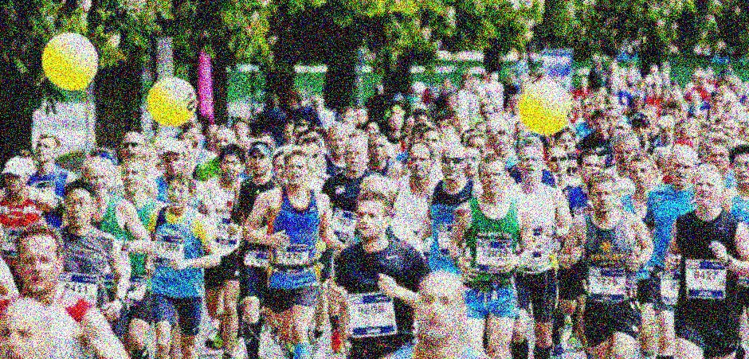
Image Quality Degradation Using Gaussian Blur and Gaussian Noise

Slide 5
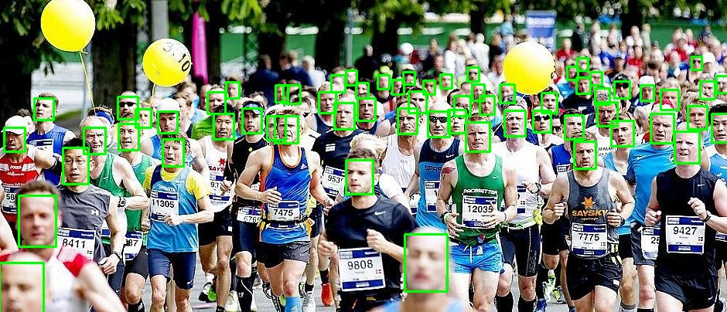
Facial Detection Using RetinaFace with InsightFace

Slide 6
Other Techniques Searched For Facial Recognition:
Haar Cascade Classifier
Multi-task Cascaded Convolutional Networks (MTCNN)

Slide 7
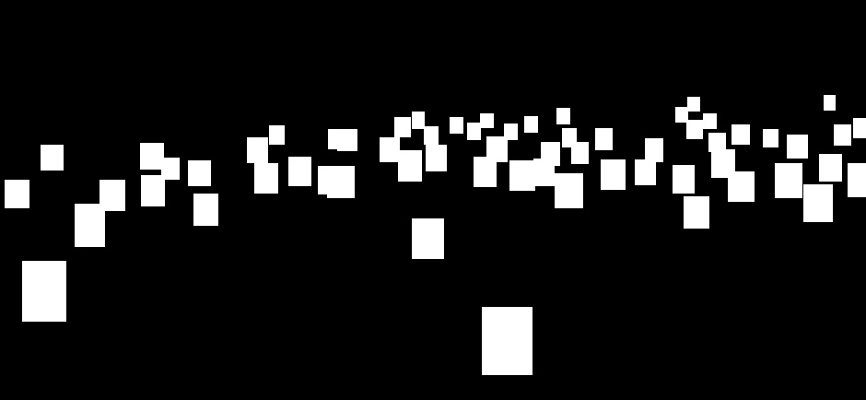
Mask Generation Using RetinaFace with InsightFace:

Slide 8
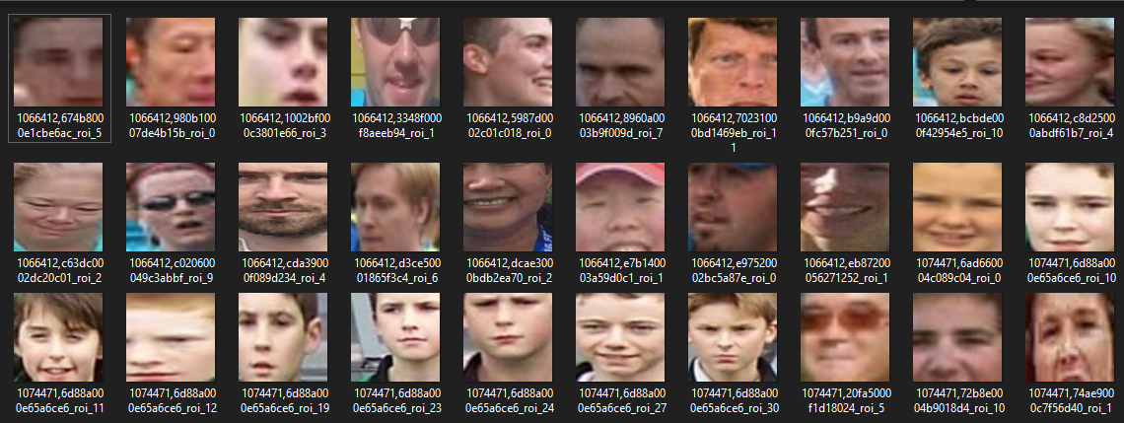
Face Extraction from Crowd Images Using U-Net Segmentation"
Detected Images by the Model:

Slide 9
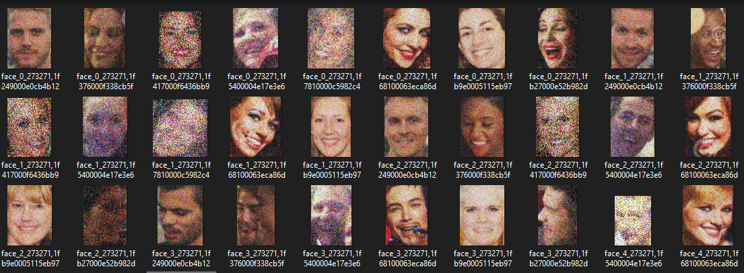
Blurred Facial Images Using Gussian Blur and Gussian Noise:

Slide 10
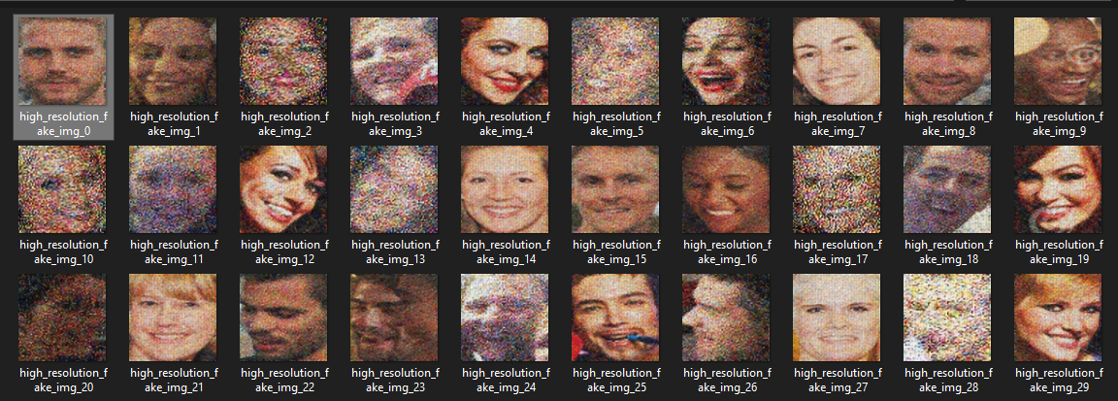
Super-Resolution Face Generation Using GANs with PyTorch

Slide 11
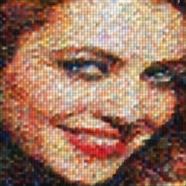
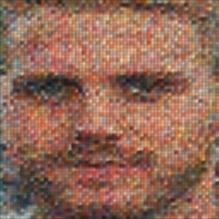
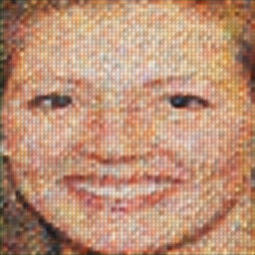
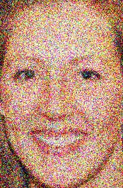
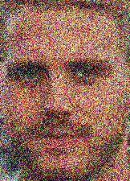

COMPARISION:
SUPER RESOLUTION IMAGES
ORIGINAL IMAGES

Slide 12
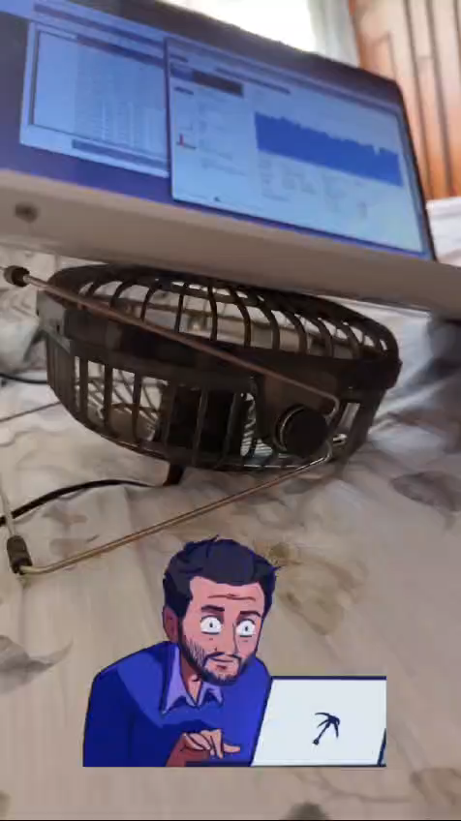
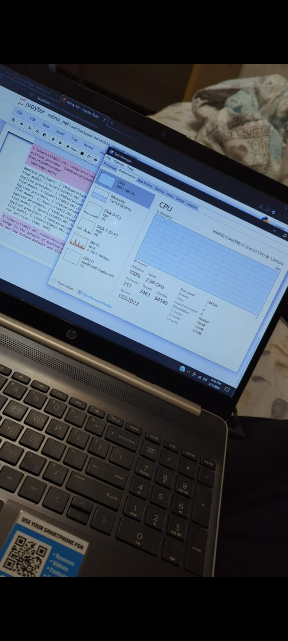
Reason Of Bad Results:

Slide 13
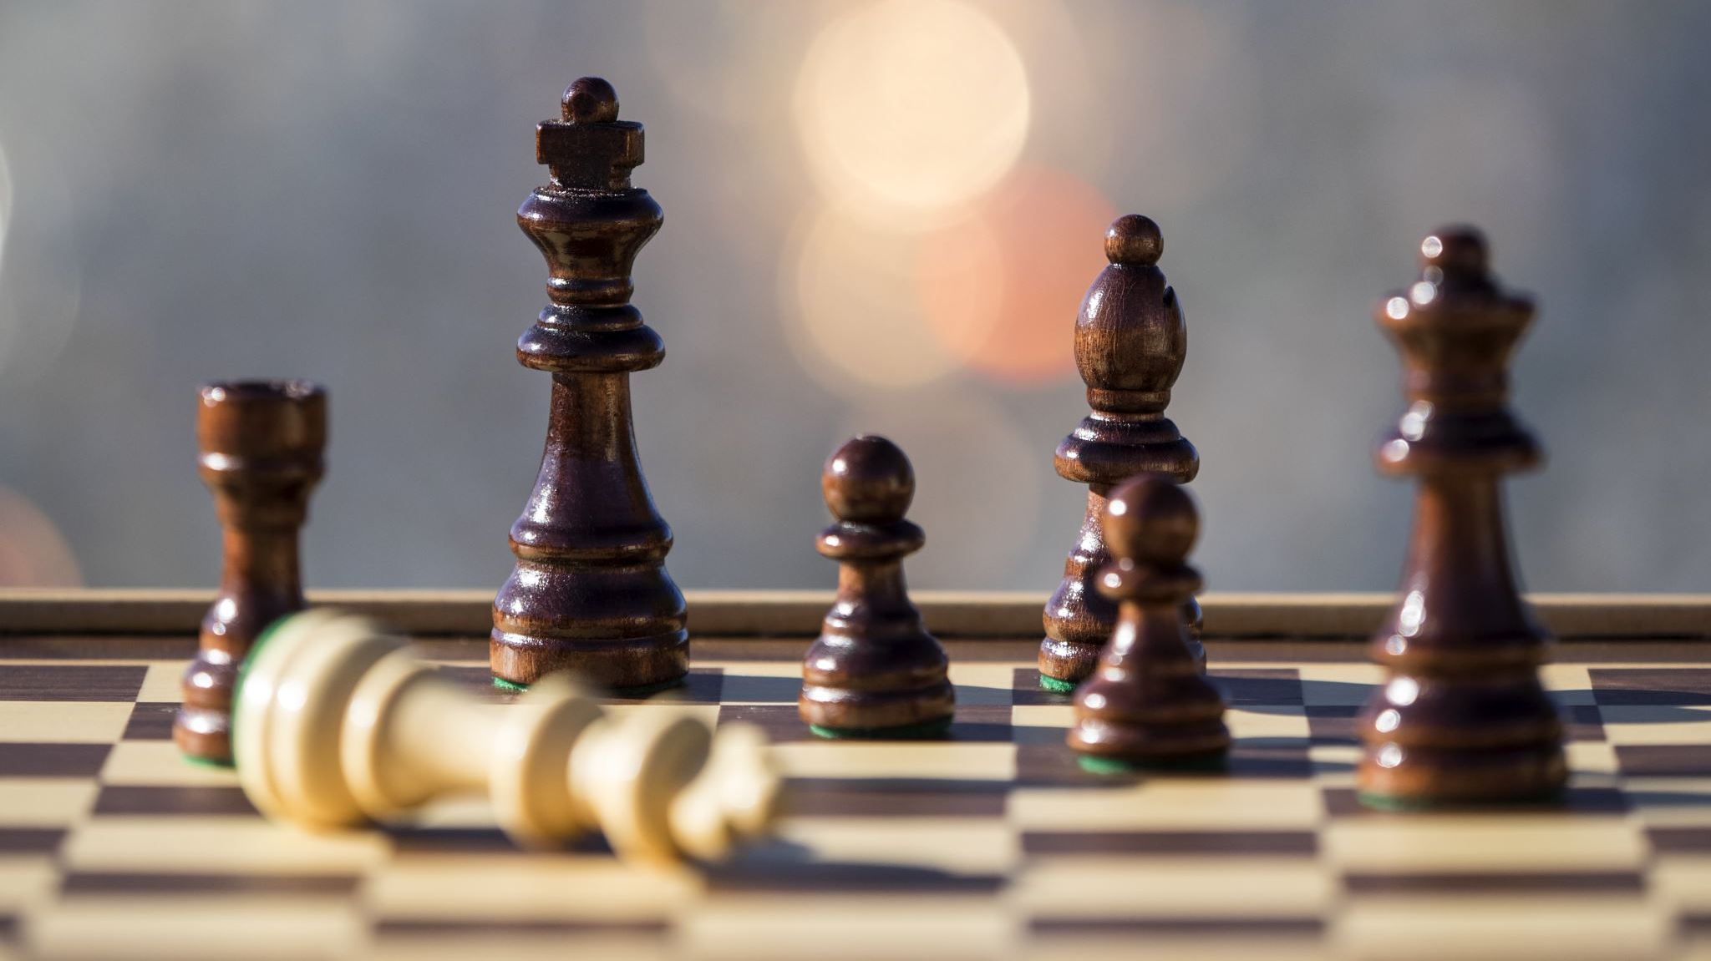
THE END

